Slide 1
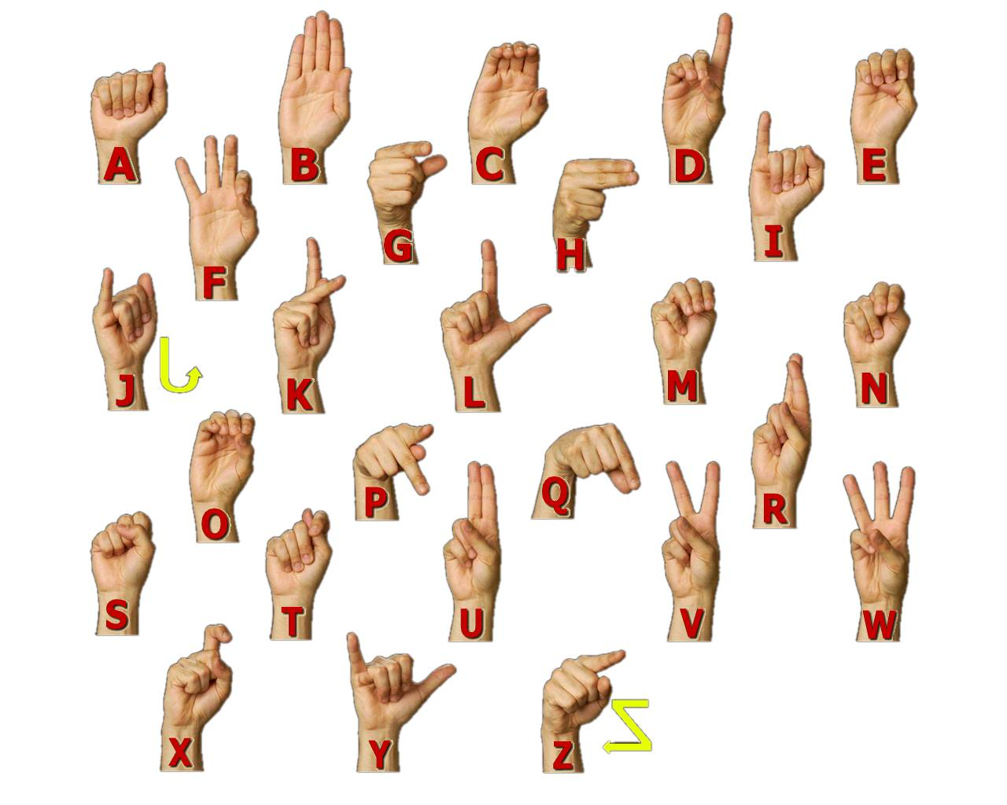
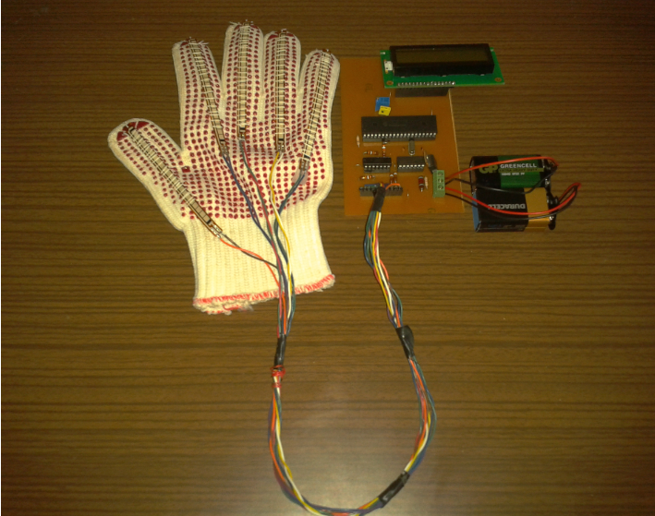
Development of a Flex Sensor Glove
<Your Names>
Supervisor <Title and Name of Your Supervisor>
Example Poster
size 53 cm by 75 cm
Department of Electrical and Electronics Engineering, University of Gaziantep,Turkey.
Abstract
A flex sensor glove is designed and constructed to translate hand gestures into words. The system is trained with a small sample of gestures based on the American Sign Language (ASL). A gesture is translated into the written word and displayed on a computer screen or LCD display.
American Sign Language Alphabet
Signal Flow Chart
Glove
Flex Sensor
Flex Sensor Circuit
MCU
LCD
Main Components
Flex Sensor, op. amp, PIC, microcontroller, LCD, battery, glove.
Main board and Glove
A flex sensor is placed on each finger in order to convert finger positions into electric signals. The signals are processed by the circuit and PIC program, which constitute the translator part of the prototype. The combination of the processed signals gives a letter that the gesture corresponds to in ASL.
Conclusion
The flex sensor glove prototype successfully reproduces a small sample of ASL gestures after careful training. Further improvements to the hardware and software would allow for training of the remaining ASL characters yielding a system that would be useful for hearing- and speech- impairment people.
References:
http://www.cs.sfu.ca/~amulder/personal/vmi/PCVR.html
How to build an instrumented glove based on the Power glove flex sensors.
http://www.ee.ualberta.ca/~rchapman/Cmpe401/lab1.html
Lab for Computer Interfacing course at the University of Alberta using a flex sensor.
http://www.robotmag.com/robotics/h-bend-sensors.html
"Playing with Bend Sensors" by Marvin Green in Robot Science & Technology online supplement.

